Slide 1
Survey on Soft Gripper and Manipulator
For RBE 595 Soft Robotics Spring 2018
By Rishi Khajuriwala

Slide 2
Motivation
Adaptivity
Lower Cost
Complex grasping
Rise of Service Robots
Combining Soft robotics with Conventional Robotic designs
Notes:
In grasping applications, the compliant soft grippers could adapt to object
shapes without specific control inputs, dramatically reducing
system complexity and cost, while improving grasping performance
and safety [3], compared to rigid robotic grippers [5]
Furthermore, to achieve inherent
compliance and adaptability, the soft material could combine
conventional robotic hand designs with different finger joint
actuating mechanisms, such as tendon-driven [17]–[19], gear
and rod [20], [21], or driving rigid joints directly [22]. How
ever,
the inherent compliance of soft grippers often limits their
maximum force output. hence limiting grasping reliability and
payload capabilities [9], [10].
Further we all know how heavy the conventional robots are so we can use this soft grippers to overcome that problem.

Slide 3
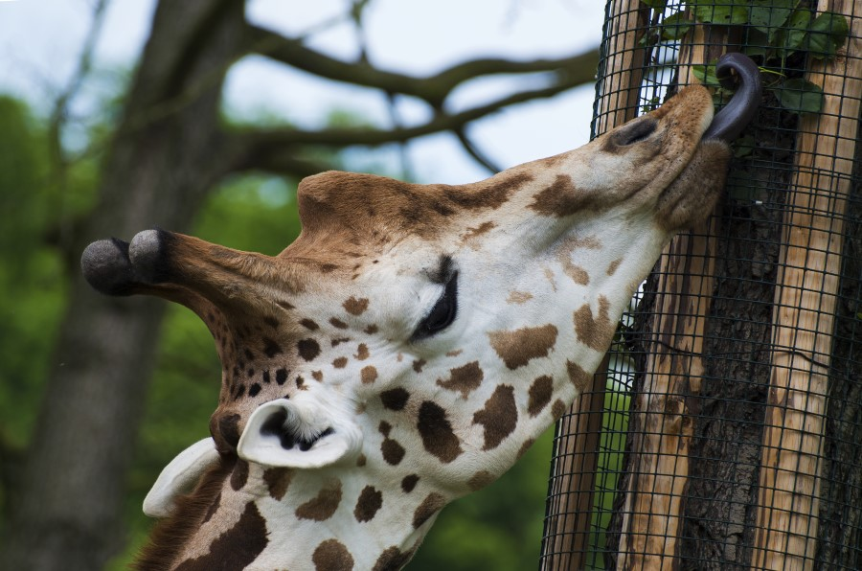
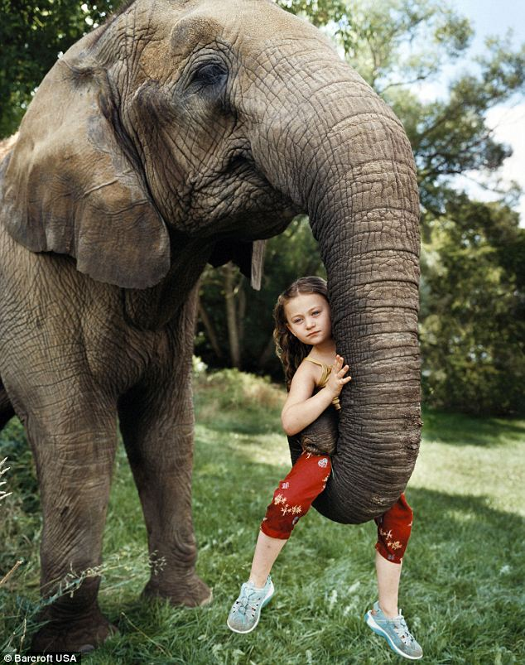
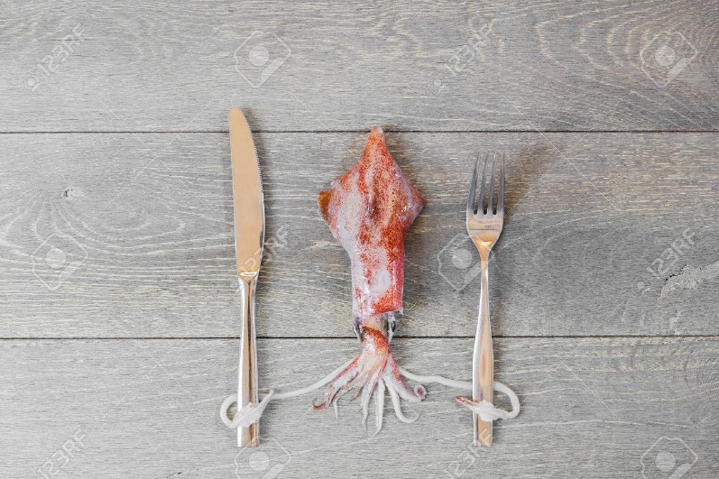
Inspiration
Notes:
For
instance, giraffes wrap their tongues around high tree
branches to strip off leaves. They can also use their
tongue to delicately pick leaves while avoiding the
spiny thorns of acacia tree branches. Elephant trunks
are amazing appendages that are strong enough to
knock over trees, yet agile enough to pick straw off the
ground. Squid have ten arms, two of which are tentacles.
Tentacles are specialized arms used specifically
for quick-strike prey capture.

Slide 4
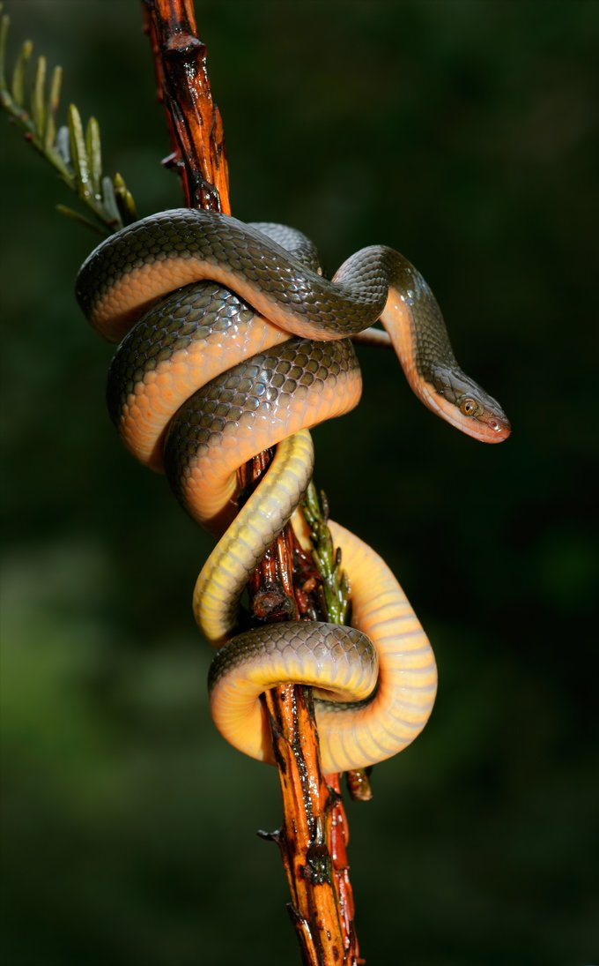
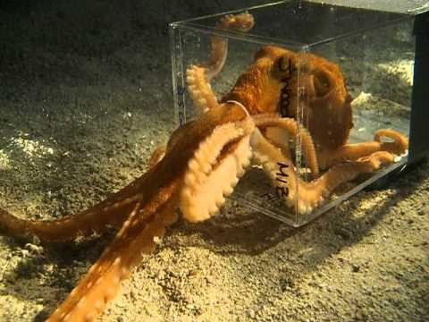
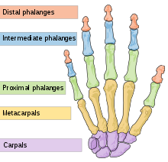
Inspirations[12]
Notes:
https://www.youtube.com/watch?v=949eYdEz3Es

Slide 5
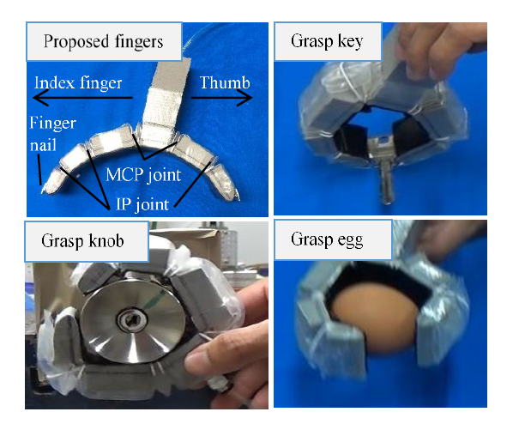
Literature Review
Lightweight Underactuated Pneumatic Fingers[1]
Notes:
Inspiration from Human hand
Basic Motion of the finger can be divided by flexion-extension motion, abduction-adduction motion and rotating motion of the thumb
Motion acted together with several fingers is called grasping.
Grasping is divided into 2 parts
1)Power grasping (mostly heavy objects)
2) Finger tip grasping(for objects smaller than finger circumference)
In this paper they have used this fingers to open a door knob and this fingers are attached to an aerial manipulator.

Slide 6
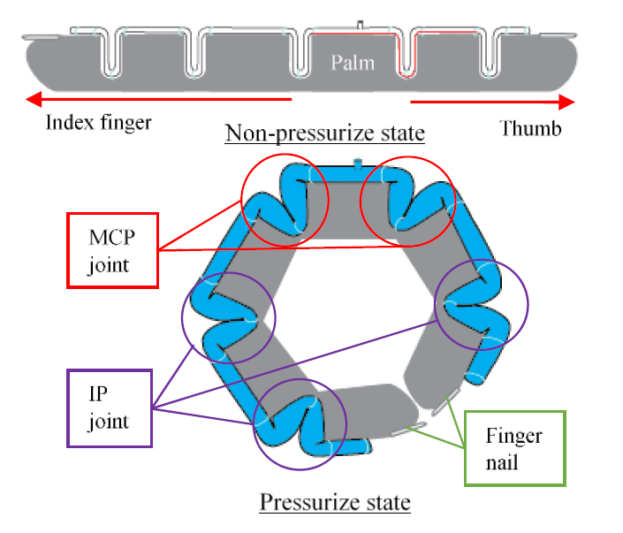
Design:
Notes:
Here, the design is based on human finger
By taking only thumb, index and small portion of palm without reducing the capability of both power and fingertip grasping
They have also designed a finger nail for finger tip grasping
The joints made by flat tube pleated into zigzag structure and connected together to all the joint (IP(Interphalangeal ) and MCP(Metacarpophalangeal) joints) in one chamber of tube so that it could produce one degree of freedom flexion motion of grasping. Joints generate bending motion when pressurize with pneumatic energy source by expanding the zigzag tube into hemisphere-like structure which then transfer the force to bend the finger phalange.
Actuation of joints is very important for the grasping phase.
In this case, we set the sequence
which both MCP joint move first followed by middle IP joint
and the last distal IP joint. As a result, a fingertip grasping
can be performed while power grasping could also be achieved for object with size larger than fingers circumference
For designing the fingers they have taken few parameters
Uniformly distribution force
Joint angle Torque formulation
Parameter selection for the finger

Slide 7
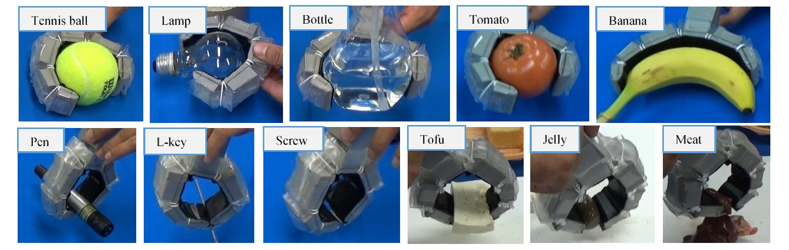
Experiments
Notes:
As you can see from the image they have grasped various ADL activities of Daily living objects from their gripper.
The finger actuator was
137 gram and 163 mm and had a force of 11.07N contact force
They had uniform force distribution
The fingers could generate force by weight ration around 2.5 times larger than the existing finger actuator (with metal gears they had made earlier)
Now the question comes why to design and make this light weight fingers.
Build a lightweight and large grasping force finger
actuator is important especially when the weight factor is
crucial such as for aerial manipulator.

Slide 8
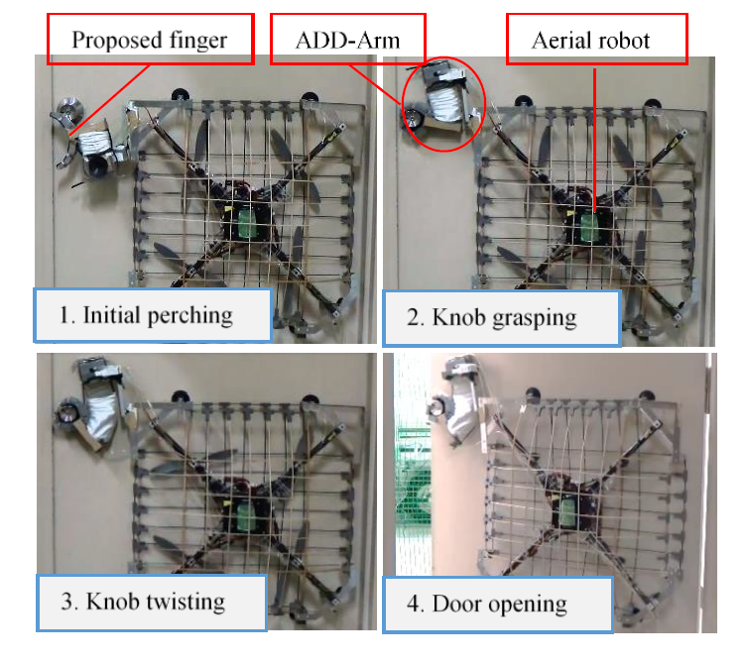
Application
Notes:
Build a lightweight and large grasping force finger
actuator is important especially when the weight factor is
crucial such as for aerial manipulator.
Our previous research on aerial manipulator to open the door had been introduced
here [6]. With this concept and our proposed lightweight
finger actuator, we can expect the robot to perform door
opening mission for both round and bar type knob.
The
performance of door opening function can be seen in fig. 9.
In order for the robot to be able twisting door knob, the
robot must perch on the environment.
In this robot, we use
two-pair of suction pad for attaching the whole body of
aerial manipulator on the door plane.
By controlling the
vacuum activation sequence, we can perform both perching
and detaching behavior as had been explained in [6].
Lightweight manipulator is also important considering the
payload limit of aerial robot. Built general manipulator
composed by servo motor and link is not enough to handle
the weight limit.
We introduce ADD-ARM which have
weight 40% lighter compare with general manipulator [6].
It
also transferred the force effectively while negate the knob
torque spring when twisting
. The end effector of the
manipulator then installed with our finger actuator so it could
grasp and twist the door knob.
To open the door, after the
robot perching, it push the door by using thrust force from
the propeller.

Slide 9
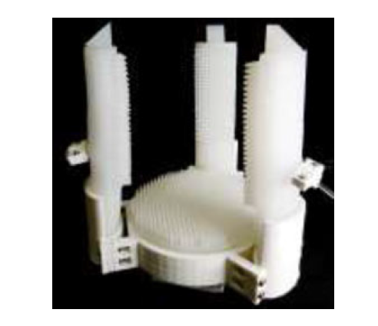
Literature Review
A Soft-Robotic Gripper With Enhanced Object
Adaptation and Grasping Reliability[2]
Notes:
In this work, we aim to design a soft grasping system with
both adaptation ability and robust grasping security. A novel trifingered
soft-robotic gripper is proposed, comprising of three
dual-chambered ellipse-profile soft pneumatic fingers, and a
novel palm design with a compliant chamber. Both the fingers
and the palm featured surface textures for enhanced grasping
reliability. The resulting soft-robotic gripper with 406 g selfweight
could securely hold 4 kg payload at an input pressure
of 100 kPa, sufficiently covering most objects in ADL. The
design of the soft-robotic gripper will be presented in Section II,
followed by the fabrication process in Section III. Experimental
results on the fabricated gripper will be presented in Section IV,
with conclusions in Section V.

Slide 10
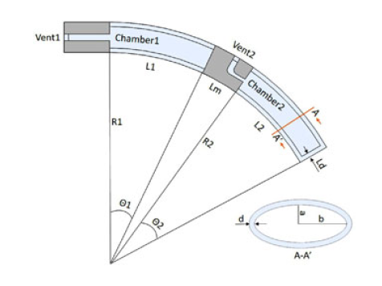
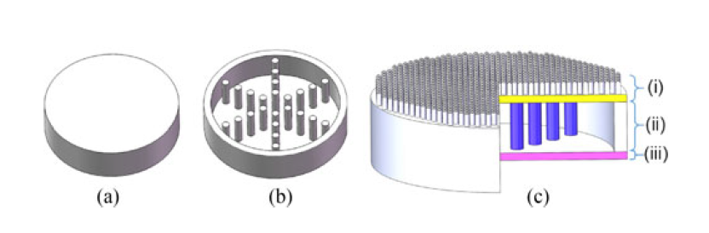
Design
Notes:
The proposed soft bending actuator in this study comprises
of two axially-aligned sections, with each section actuated
independently, as shown in Fig.
The independent
sections enabled two actuation modes of the finger:
1) If the two chambers are pressurized with the same input
pressure, the deformation of the proposed finger will be
similar to the single-chamber actuator in [23] with similar
dimensions.
2) If the two sections are actuated independently, resulting in
different θ1 and θ2 angles, the actuator could reach larger
area than the first mode, allowing the finger to conform to
complex-shaped objects.
Palm design:
The proposed cylindrical palm design consists of a passive
air chamber with a soft material passive compliant surface supported
by supporting pillars as shown in Fig. 4(a) and (b).
The pillars were aligned in a hexagon pattern and divided the chamber
into six segments. Therefore the palm could offer three
different compliance levels as shown in Fig. 4(c):
a) unsupported
surface: lowest stiffness, easiest to deform;
b) supporting
surface: medium stiffness, still deformable; and
c) hard bottom
surface: highest stiffness, non-deformable
Gripper design:
In the gripper design, we aim to achieve reliable grasping
from the compliant nature of the proposed soft actuators, while
maintaining a simple structure. A tri-finger-single-palm setup
was selected, with reference to the thumb, index and middle
finger as the most important fingers in grasping [12], [13], [21].
There is a 120 degree angle between each pair of adjacent fingers
The grasping volume of the
gripper is adjustable by changing the finger mounting angle θ
own in Fig. 6(a)

Slide 11
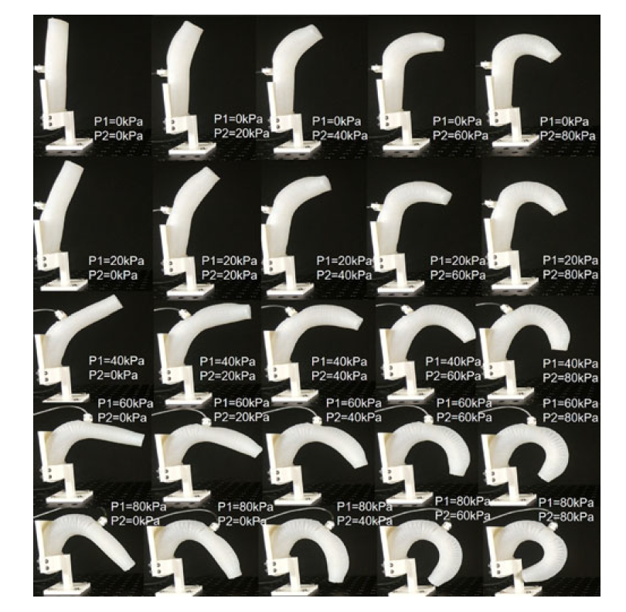
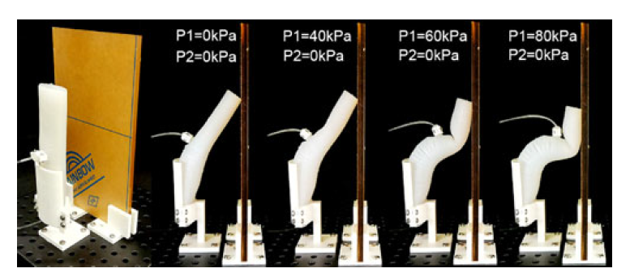
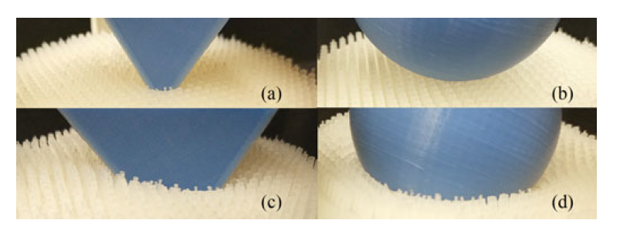
Experiments
Notes:
In this experiment, we present the relationship between the
supplied pressure and the bending motion of the finger. Since
the proposed finger has two individual chambers, let P1 be the
supplied pressure of the Chamber1, and P2 for Chamber2, different
P1 and P2 values would result in various finger motions,
as shown in Fig. 8. Without external load, the soft finger could
reach a full bending of 360 degrees with 80 kPa supplied to both
chambers.
Another novel function of the proposed soft robotic finger
is the passive compliance of the unactuated section. When the
soft pneumatic actuator is pressurized, the deformation ability
is determined by the supplied pressure. A zero-pressure section
will exhibit the largest passive compliance. In this experiment,
the soft finger was mounted to a mounting base, with a fixed
board near the bending direction. The first finger section was
actuated while the second section was kept passive. As the first
section bent, the second section was gradually buckled against
the board mounted opposite to the finger, with the entire first
section in contact with the board at a very large contact area, as
shown in Fig. 9. The passive compliance is especially useful for
grasping large and flat objects.
To assess the effectiveness of palm passive adaptation, two
objects were tested: a sphere and a tetrahedron as shown in
Fig. 13(a) and (b). The palm conformed well to the contour of
each object, which suggests that the passive adaptable palm is
easy to wrap edges, corners, and curved surface of objects.

Slide 12
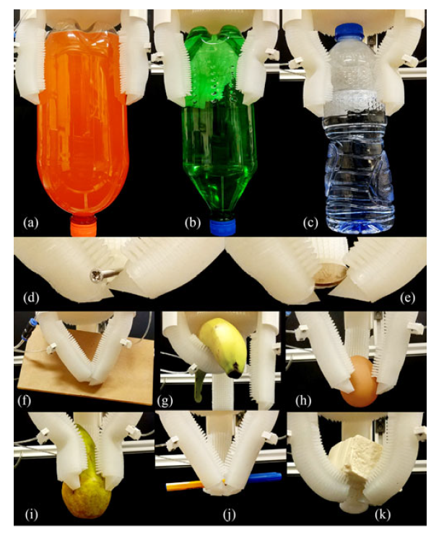
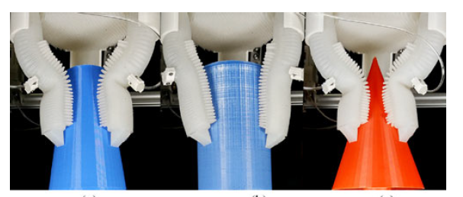
Experiments
Notes:
In the final test, the soft gripper was used to grasp a series of
daily objects.. Next, the gripper was
tested with a list of objects of ADL, as shown in Fig. 16. The
soft gripper could grasp objects of various shapes, stiffness
levels, and sizes reliably. The proposed surface feature helped
to maintain a firm grasp even with odd-shaped objects. The
proposed finger nail could pinch up small cylindrical objects as
in Fig. 16(d) and (e). As shown in Fig. 15, three sample objects were
3D-printed with inclining sliding surfaces. With the passive
first section and the proposed surface features, the soft gripper
could handle all of the objects reliably

Slide 13
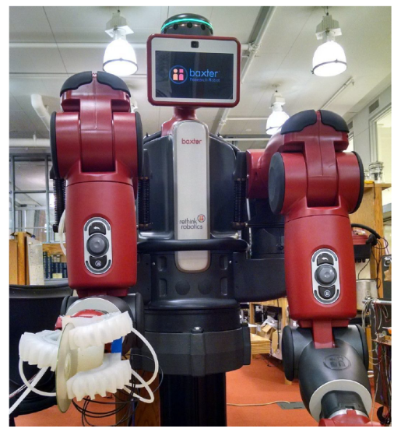
Literature Review
Haptic Identification of Objects using a Modular Soft Robotic Gripper[3]
Notes:
In this paper we present a new soft robotic gripper
with proprioception. The proprioceptive sensors enable us to
. recover certain features of the configuration of the fingers
Each finger in our multi-fingered hand is designed based
on the soft manipulators outlined in [9], [10].
We modify this
design by adding a bend sensor to measure the curvature of
a finger around a certain axis.
Furthermore, we add a new
constraint structure to limit the finger to curve only along
the axis we can sense

Slide 14
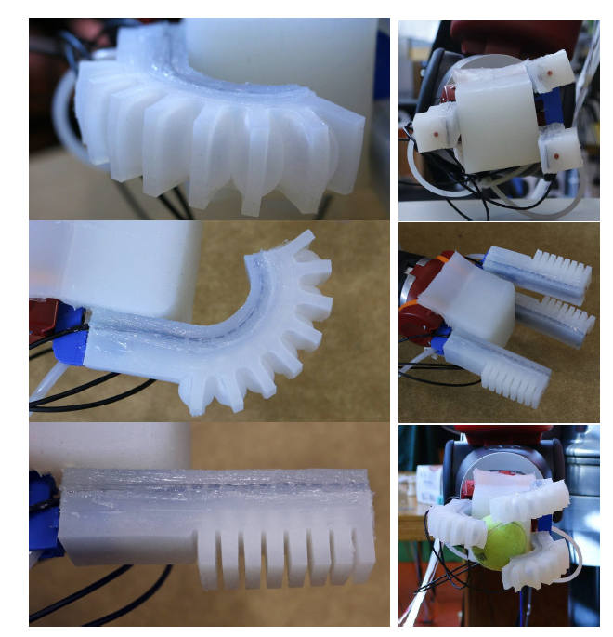
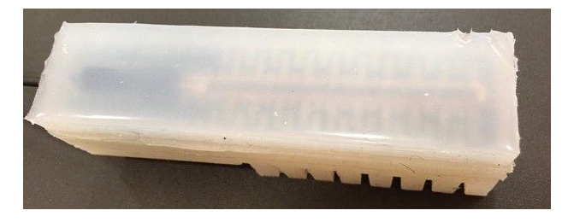
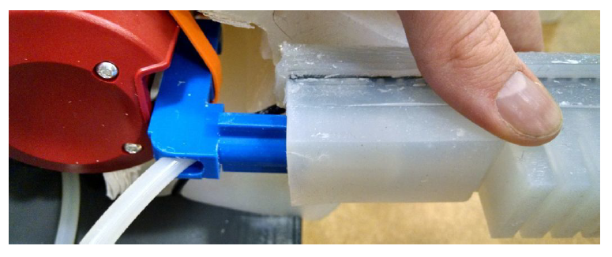
Design
Notes:
We designed this gripper with the following key goals in
mind:
1 Ability to grasp a range of objects
2 Ease of fabrication
3 Modular interface to existing hardware
To this end, we developed a gripper consisting of three
individual soft fingers that can be slipped onto 3D-printed
interface (see Figure 2). The interface piece screws onto an
already existing robot hardware. We prioritized a modular
interface in order to enable the gripper to be usable for
a variety of existing hardware bases simply by swapping
out the 3D printed interface. The fingers are identical in
their design; this modularity allows for faster fabrication
and therefore more rapid design iterations. The soft fingers
and their composition allow the gripper to grasp a range of
objects with varying diameters.
We designed each finger with several key goals in mind:
1 Internal state sensing capability
2 Constant curvature bending when not loaded
3 Partially constant curvature bending under loaded conditions
4 Highly compliant and soft in order to be inherently safer
So far, most soft manipulators require exteroceptive sensing
to estimate their bending state. During manipulation
tasks, an external tracking system can be blocked by objects
within the line of sight so that the observation of the
curvature of each finger is not always possible. We therefore
decided to enable the gripper with internal sensing to give the
user more flexibility during manipulation tasks.
A resistive
flex sensor was embedded into each finger by affixing it
on top of the finger’s inextensible constraint layer. Bending
the resistive strip changes the resistance of the sensor. The
resistive change can be correlated with the curvature of the
finger under the assumption that the finger bends with a
constant curvature. This only holds true for the unloaded
case; in the loaded case, partially constant curvatures can be
assumed between points of loading.

Slide 15
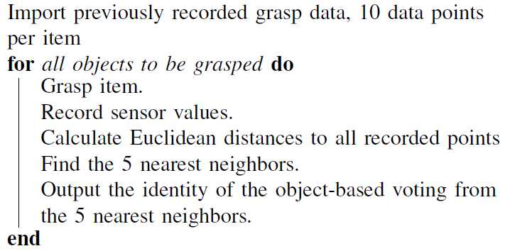
Haptic Object Identification
Notes:
Look up the paper in hand to find about it
Explain K-means clustering
And explain accordingly

Slide 16
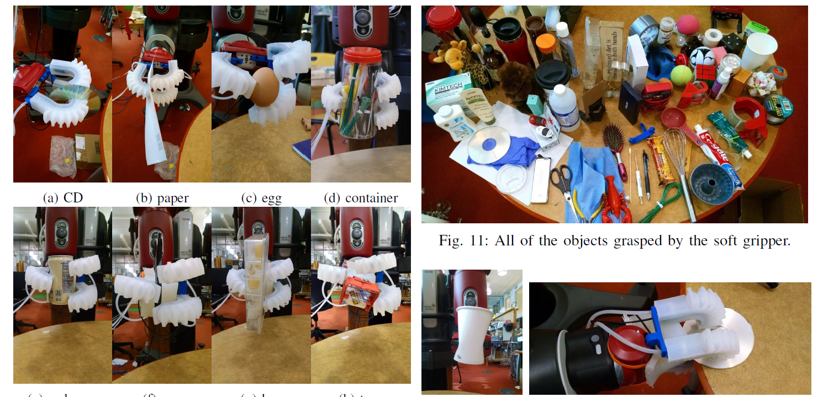
Experiments
Notes:
The gripper had trouble picking up a
slippery chopstick and toothbrush, though it had no issues
picking up similarly sized pen or long Q-tip. The gripper was
unable to pick up a slippery calculator and a small book,
though it was able to grasp other heavier objects in other
configurations. The gripper was unable to pick up a heavy
action figure.

Slide 17
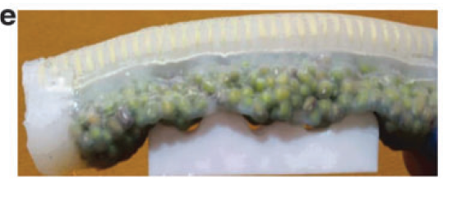
Literature Review
A Novel, Variable Stiffness Robotic Gripper Based on Integrated Soft Actuating and Particle Jamming [4]
Notes:
In this article, we demonstrate a novel design of a compliant
robotic gripper based on pneumatic soft actuator and
particle jamming. The proposed multifingered gripper can
passively conform to object geometries and execute robust
grasping.
Variable stiffness is a promising solution
to make up the weakness of pneumatic soft robots.
Soft pneumatic robots can grasp the objects but can hold it tightly so variable stiffness is needed to overcome this weakness.

Slide 18
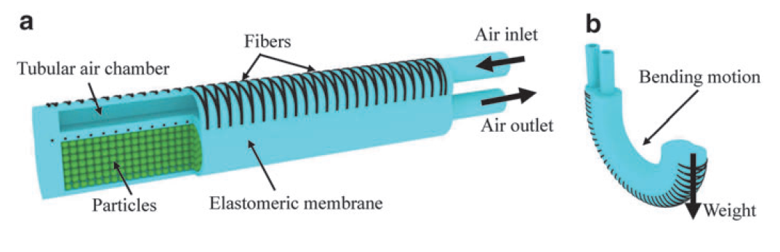
Design
Notes:
Explain from the figures

Slide 19
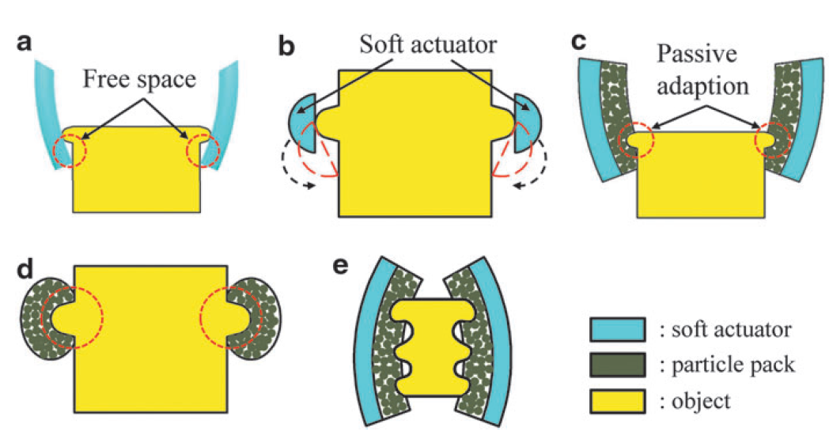
Particle Jamming
Gripper
Notes:
Explain from the figure
About the difference between a normal pneumatic actuator
And the particle jamming
Explain about the human hand
That how when open our fist the palm becomes soft and when we close it the palm becomes rigid.

Slide 20
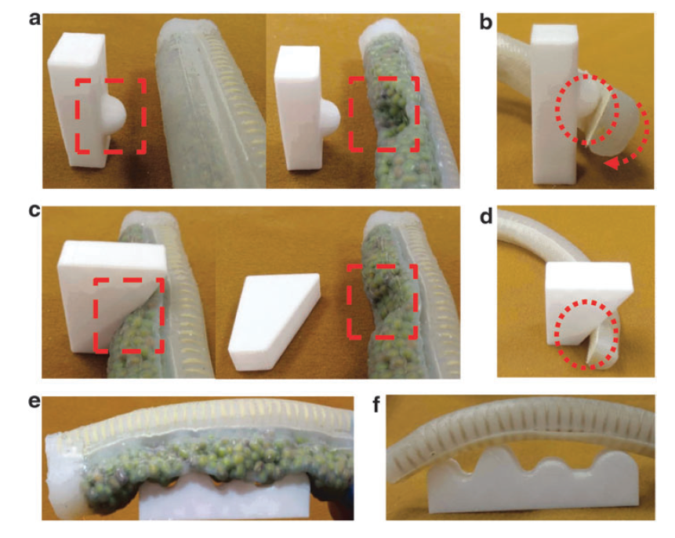
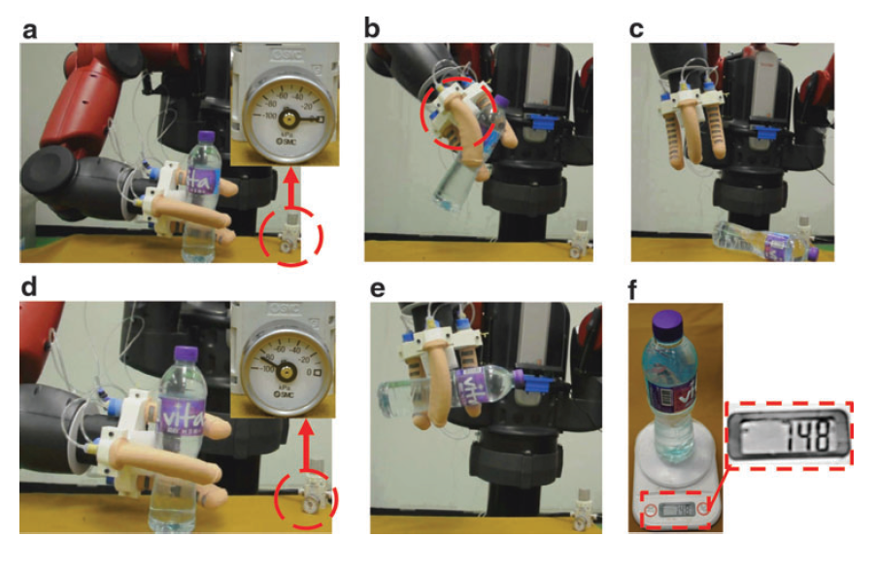
Experiments
Gripper
Notes:
Explain about the experiments from the images
Difference between normal and particle jamming
Explain about the baxter that how the bottle falls without particle jamming

Slide 21
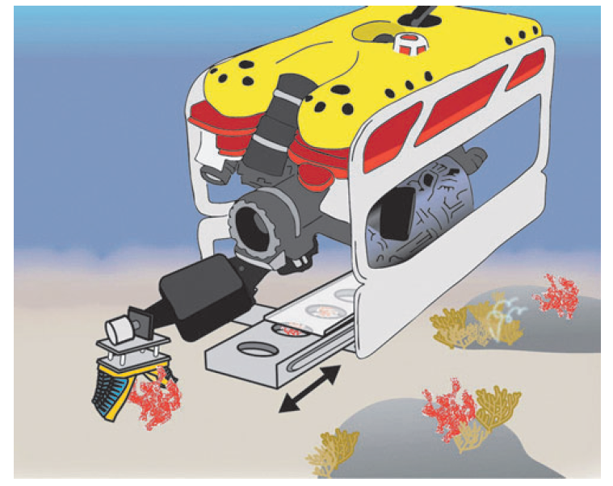
Literature review
Soft Robotic Grippers for Biological
Sampling on Deep Reefs [5]
Notes:
Commercially available deep sea manipulation systems
are designed to perform heavy mechanical work (i.e., construction
or pipeline maintenance) and are not geared to
perform delicate tasks, such as the collection of fragile biological
specimens.
The soft robotic actuators employed in our grippers are
monolithic structures (i.e., no moving parts such as pin joints,
gears, or linkages) and are modularly coupled to a palm. Their
structure is based on the PneuNet and fiber-reinforced soft
actuators developed at Harvard16,21 and have proven robust at
depths greater than 800m underwater in field testing (see
Appendix for further discussion on depth testing).
The simple
construction, inexpensive materials, and modular design of
our soft grippers allow us to quickly modify or repair a system
in the field with minimal expense and mechanical expertise

Slide 22
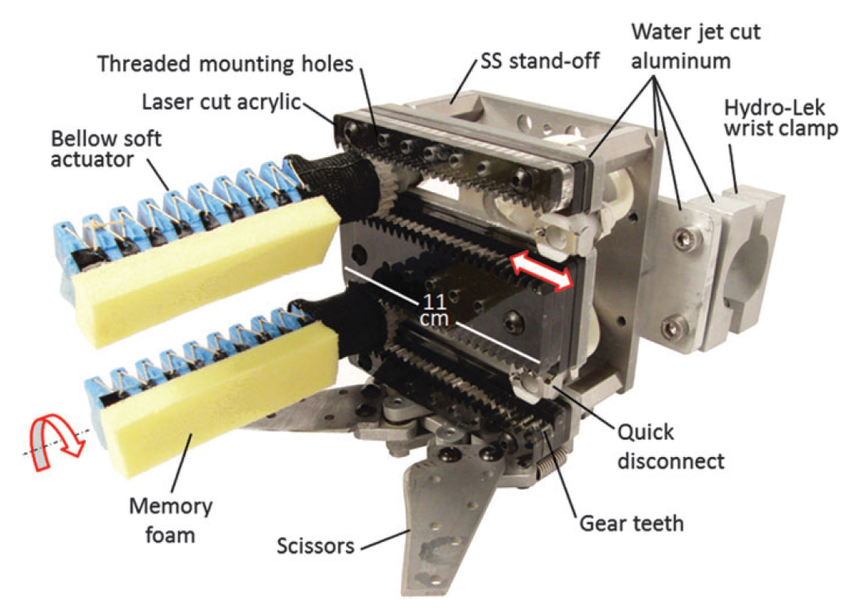
Design
Notes:
The soft gripper’s palm is designed for rapid and inexpensive
customization. The palm structure was assembled
from sheet materials: water jet-cut aluminum and laser-cut
acrylic (Fig. 4). Four thru-wall female quick-disconnect fittings
were positioned in recessed channels formed from
stacked layers of acrylic.
The relative spacing of the fittings
can be manually adjusted. Furthermore, laser-cut gear teeth
in the acrylic run parallel to the slots and match the 3Dprinted
spur gear teeth integrated into the soft actuator base.
When the gear teeth engage, this locks the position of the
female quick-disconnect fitting and orientation of the soft
actuator. Note that without the gear teeth, the actuator can
passively rotate about the axis of the quick-disconnect fitting.
The palm surface also features a variety of threaded holes that
serve as anchor points for palm textures and other accessories.
Stainless steel stand-offs create an open cavity between
two aluminum plates for routing hydraulic plumbing to
the female quick disconnects. These plates also serve as anchor
points for a Bowden cable-driven, four-bar linkage
cutting mechanism. Custom fittings were machined to connect
the Hydro-Lek arm’s push-pull rod to the cutter. Vented
screws terminate each end of the Bowden cable sheath and
were tightened or loosened to tension the cable. Cutting
blades were screw mounted to one of the linkages, enabling
replacement with and evaluation of new blade designs

Slide 23
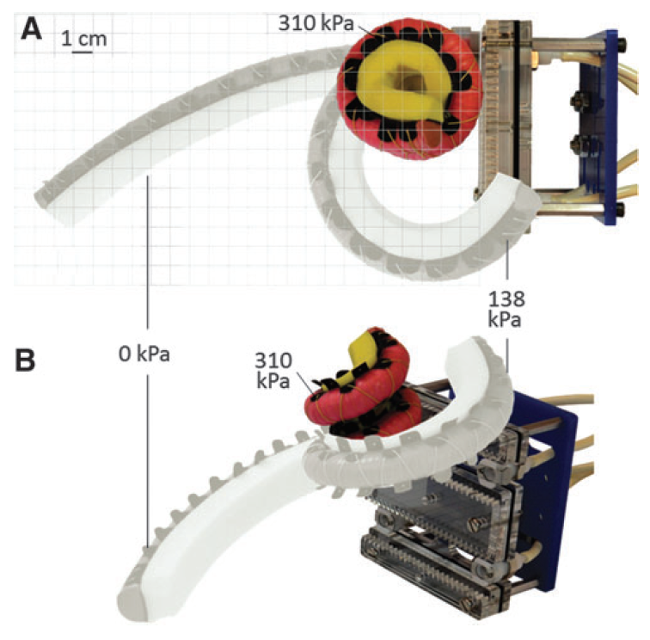
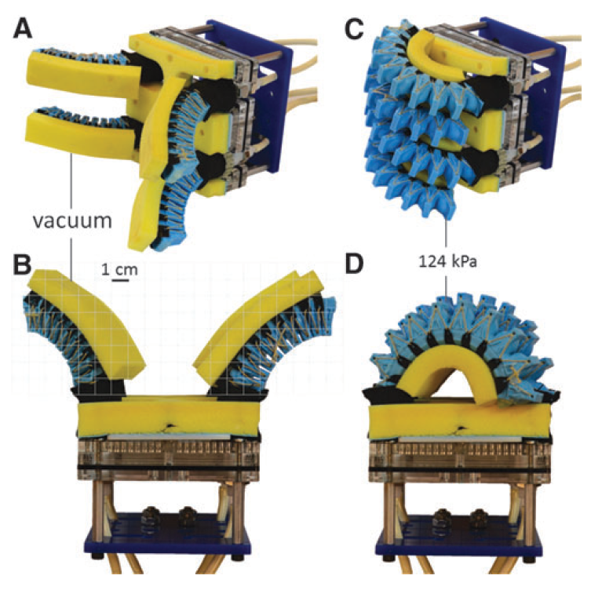
Actuators
Notes:
Boa
For example, the boa-type actuator
(Fig. 5) has a fiber-reinforcement strategy that causes the elastomeric
structure to simultaneously bend and twist to form a coil.
Inspired by the boa constrictor and tentacled cephalopods,
the boa-type soft actuator can access tight spaces and reversibly
shape change from a nearly straight beam to a helical structure
(Fig. 6). This simple motion path, which is dependent on the
actuator geometry, elastomeric material properties, and fiber reinforcement
placement, gives the actuator the unique ability
to tolerate uncertainty of sample size, shape, and stiffness. As
interior fluid pressure increases, the 300mm long, narrow
(approximately a 15mm half-round diameter) actuator wraps
around an object to increase surface area contact and distribute
forces. The boa-type actuator we developed for field testing can
wrap around objects as small as 12mm in diameter.
2) Bellow
Bellows-type soft actuators are a common architecture that
creates asymmetric motion by unfolding the excess material
in the bellows. Compared to fiber-reinforced actuators in
which the elastomer material must strain to create motion,
this unfolding approach places less strain on the material,
which can increase the longevity of the actuator and lead to
lower operating pressures. Bellows-type actuators also have
the advantage that certain geometries can support bidirectional
bending by alternating pressurized fluid and vacuum
(Fig. 8). Furthermore, fiber reinforcements can be incorporated
into bellows-type actuators to increase the actuator’s
operating pressure and output force, and to reduce its radius
of curvature when actuated.

Slide 24
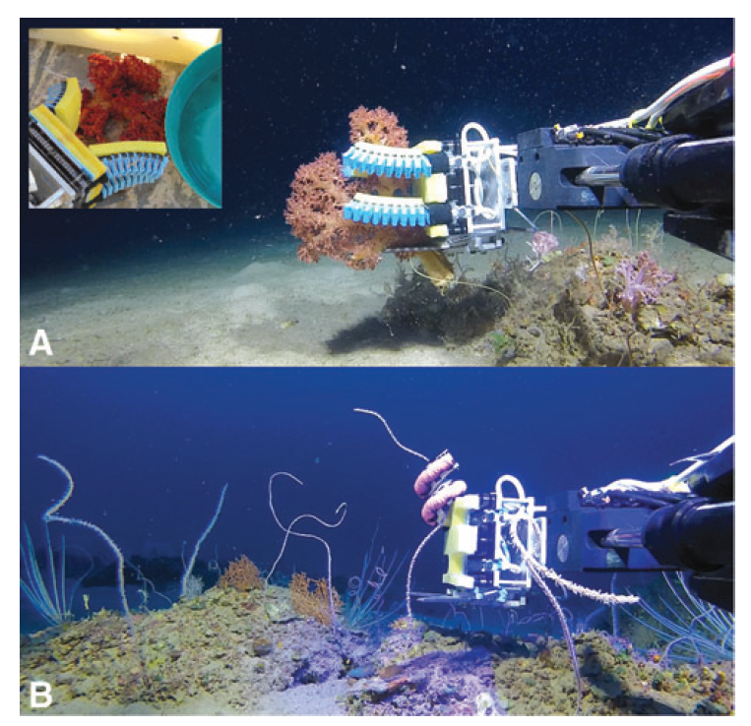
Experiment
Notes:
In a small pilot study, we brought the Deep Reef ROV and
soft robotic grippers to the Gulf of Eilat in the northern Red
Sea. To our knowledge, these field trials were the first to
demonstrate deep sea marine biology collection and manipulation
with soft robotic grippers. Figure 16 presents the two
gripper configurations that were evaluated: one with two
opposing pairs of bellows-type actuators (Fig. 16A) and the
other with a single boa-type actuator (Fig. 16B). Both gripper
configurations were operated from a single hydraulic source
and had memory foam lining on the actuators and the palm.
Using the bellows-type gripper we retrieved a red soft coral
(Dendronephthya sp.) after landing the ROV on the sea floor.
The four bellows-type actuators gently closed around the
specimen without damaging any of the branches. The boatype
gripper proved very effective at wrapping around long
and narrow (<12mm diameter) coral whips that extended
vertically from the sea floor. The large effective range of
motion of the boa-type actuator combined with the coiling
effect reduced the burden on the operator to position the ROV
and gripper in the optimal position. We repeatedly demonstrated
that once a specimen was in reach, the boa-type actuator
could draw it in and close around it. This is an
important capability because the seafloor is not always suitable
for landing the ROV (e.g., rough terrain, risk of stirring
up sediment, or tangle hazards such as fishnets may be
nearby). Consequently, the operator must try to maintain a
stable hover under external influences (i.e., currents and
tether tensioning) and slowly approach the target. Therefore,
arm and gripper designs that extend reach and quickly grasp
can improve sample recovery success while minimizing
damage to the sample and its surroundings.
In this pilot study, the soft gripperwas deployed in more than
a dozen dives at depths ranging from 100 to 170 m. On most
dives, the goal was to demonstrate that the gripper could safely
grab a specimen without removal. However, to evaluate the
sample recovery process fromstart to finish, two species,which
are abundant in the Red Sea, were recovered (see the inset
image of the recovered red soft coral in Fig. 16A). Between
dives we were able to verify the versatility of the gripper design;
the change from one gripper configuration to another
(including purging the hydraulic lines of air bubbles) could be
completed in <5min

Slide 25
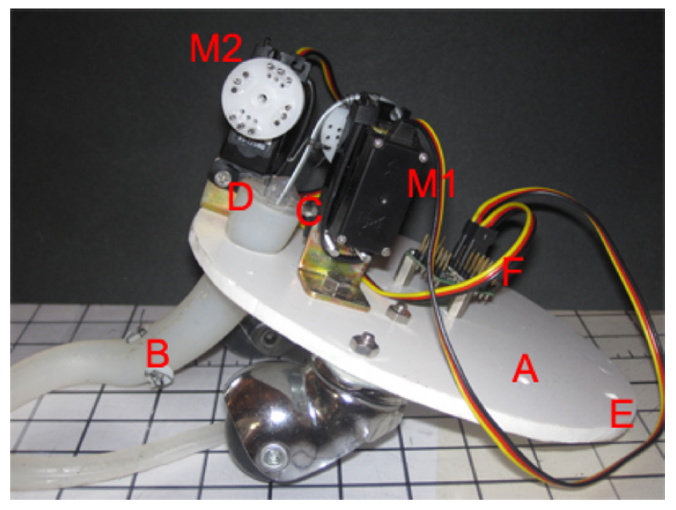
Literature Review
An octopus-bioinspired solution to
movement and manipulation for
soft robots [6]
Notes:
The octopus could be a remarkable source of inspiration
to create soft robots [16]. Its manipulation capability, together
with its ability to move on almost every kind of surface, is
of great interest to robotics.
The body of the octopus has no
rigid structures and it can easily adapt to the environment. It
can squeeze into very small and narrow holes or it can splay
over prey. The octopus has eight arms which can twist, change
their length, bend at any point along the arm and, despite the
lack of rigid skeletal support, can vary their stiffness and apply
relatively high forces [17]. The control of such awide freedom
of movement is highly distributed and it is simplified by the
use of stereotyped movements [18], such as, for example, a
temporarily reconfiguration of the arm into a stiff, articulated,
quasi-jointed structure. The eight arms are effectively used
to locomote on the diverse substrates of the sea bottom and
to reach, grasp and even manipulate objects with unexpected
dexterity, as well
In particular, in this paper we present a
soft arm, linked to a rigid base, which provides pushing-based
locomotion and object grasping.

Slide 26
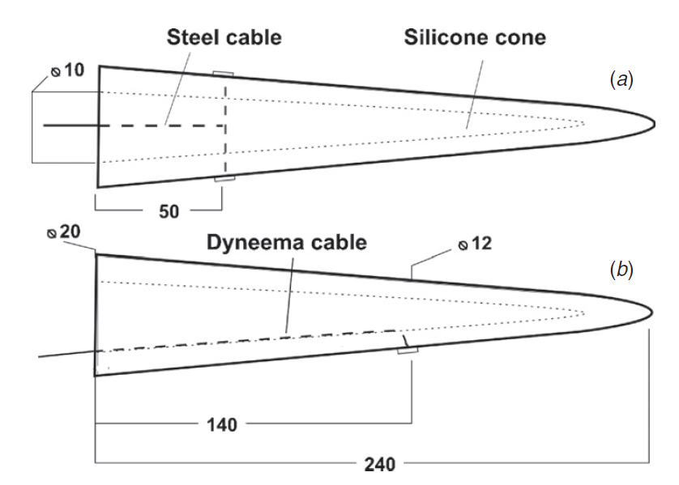
Design
Notes:
Taking into account previous
work [15]we designed a soft conical arm (B, in figure 3), which
can adapt its shape around varying size and differently shaped
objects. It also allows shortening and elongating movements
for the proximal part, and bending movement to the whole
arm. In detail, the actuation system is made of a steel cable
(C) that elongates and shortens the arm and one Dyneema R
fibre cable (D) that bends the arm. The latter mimics the
function of the longitudinal muscles of Octopus vulgaris [25],
and we anticipate now that only one cable, attached on the
tip, can bend the arm to grasp an object. We did not build
sucker-like components, as the material used to build the arm
provides the friction to stick to the ground and to grasp objects.
We may reasonably suppose that components devoted to attach
and detach the arm to a target will improve the performance,
actually the study investigated an arm structure as simple as
possible.
In order

Slide 27
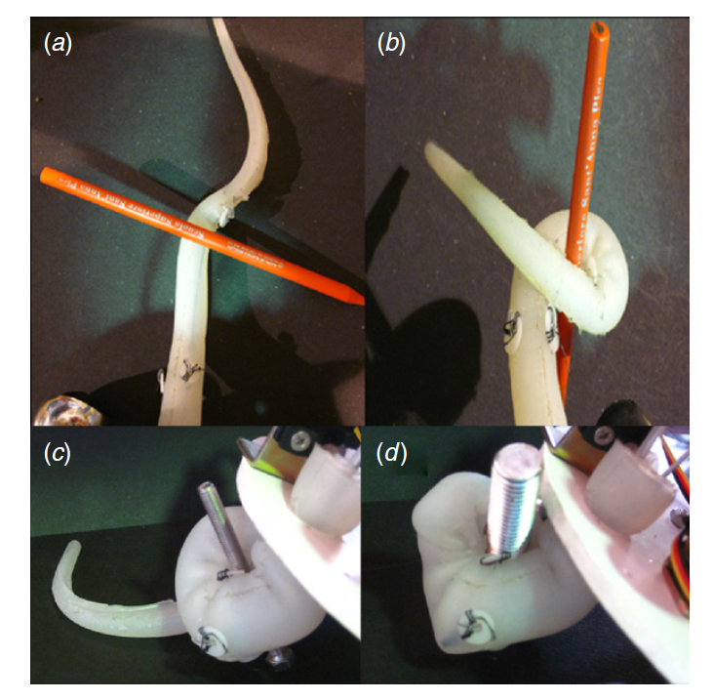
Grasping
Notes:
The living octopus arm wraps around objects sticking several
suckers to the target. In our solution without suckers, the
grasping is not equally strong. However, the silicone arm is
able to wrap around the object providing a functional grasp for
light objects. Grasping examples are presented in figure 12.
We tested if the arm could wrap around the target and if the
robot could hold the target: manually moving the robot after
the coiling, we evaluate if the grasp was effective enough to
maintain the object in contact with the robot. We coiled about
40 mm of Dyneema R cable to shape the arm in the spiral-like
configuration adopted to make it wrap around objects. This
grasp does not have high accuracy, but it is really flexible:
even if not completely wrapped around, the object could still
be held. The arm will conform to the object and will squeeze
it to the body, actually without grasping it but still providing a
frictional grip. The length available to wrap around an object
is about 90 mm, due to the difference between the length of the
Dyneema R cable and the length of the steel cable, because the
stiffened part of the arm is not involved in wrapping around.
Table 3 summarizes the result of the grasping tests.

Slide 28
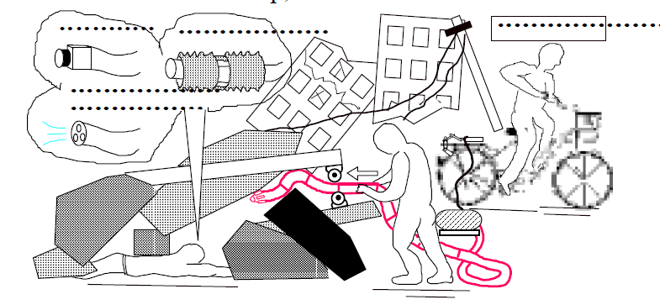
Literature Review
Active Hose: an Artificial Elephant’s Nose
with Maneuverability for Rescue Operation [7]
Notes:
This paper proposes both the design concept and the
driving mechanism of a flexible robot with multiple
degrees of freedom to dive into debris.
It is said that the victims buried alive under the
collapsed buildings must be saved within 72 hours after
a big earthquake occurs, while no equipment has been
realized which can rescue them as efficiently as we
expect. In order to improve such unfavorable
conditions, we have tried to develop a desirable robot
to perform efficient rescue operation with referring to
the report of Hanshin Big Earthquake hitting Japan in
1995 and concluded that the functions of an elephant’s
nose are extremely effective, because i) it has multiple
degrees of freedom with flexibility, ii) it can curve and
grasp the object with small curvature, and iii) it can
carry the fluid just like a hose. The robot with these
functions would be expected to perform the following
operations as shown in Fig.1, which are (1)getting into
debris to search the victims by installing the camera,
(2)supplying fresh air or water to keep them alive,
(3)carrying the air jacks to let them out, and so on.
In order for the robot to pass through such a narrow
space, it is requested to have structural flexibility with
large output force, which can be achieved by pneumatic
energy with simple control. However, the compressor is
unable to work when the electricity lines are suspended
by the big earthquake. Therefore, we started developing
a human-powered pneumatic pump with high energy
transform efficiency as the practical power source,
which takes advantage of the bicycle[1] driven by rescue
parties or onlookers, shown in Fig.2. And this kind of
pedaling style pump is considered to be helpful for the
robot we aim to develop, too

Slide 29
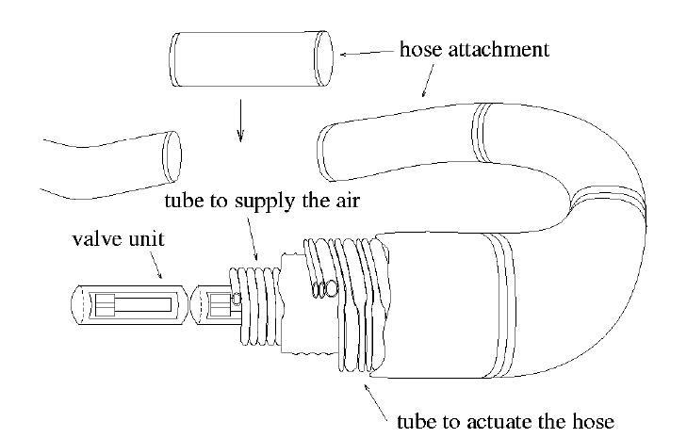
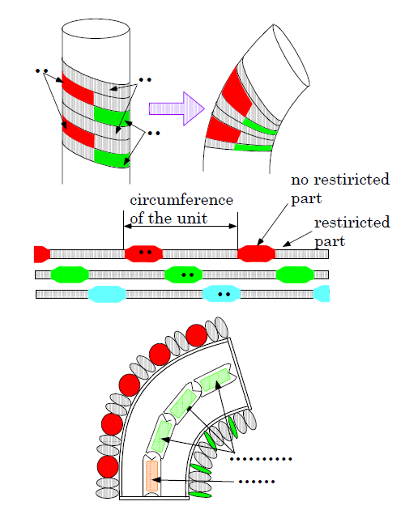
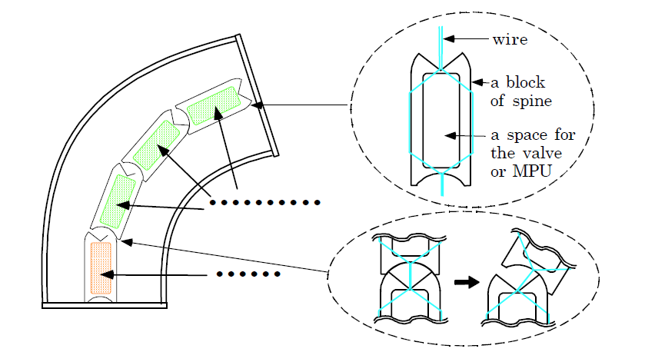
Design
Notes:
Whole structure of “Active Hose” is as shown in Fig.3.
It can partially curve and perform multiple degrees of
freedom by connecting short units in series which have
each two rotational degrees of freedom around its pitch
and yaw independently. In each unit, the control valves
are installed and they are connected to a tube to supply
the air which is shared among all the units. Since all the
units also share the signal line and the electric power
line, the number of lines doesn’t increase at all even if a
lot of units are connected.
It is necessary for a unit itself to possess the structure
to reinforce the bending moment and to minimize
curvature, considered that it must push its way in the
small space under debris. Therefore, a spine structure
installed to its center which helps the unit to be shrunk
passively when the opposite side is stretched. The spine
structure is composed of some blocks, and each block
houses valves or MPU, which helps to obtain enough
space for the fluid for life extension. In order to
connect each block, the wire combination mechanism
shown in Fig.4, is introduced, which enables units to be
connected occupying smaller spaces than the universal
joint.
When
its inside is pressurized, the tube pushes each other to
its radius direction as its cross section changes into the
circle gradually. In addition to its structural simplicity,
WT Actuator possesses a few advantages as follows. i)
It can stretch the object easily after winding around it.
So it may work as a “wearable fluid power” such as a
power assist with flexibility if it is wound around an
elbow or a knee. ii) It takes advantage of the force to
the radius direction of the tube, not the stretch of the
thrust direction, therefore a tube of high resistance to
pressure can be utilized keeping flexibility. iii) It works
as a virtual spring as the contact area to the next tube
decreases in proportion to the displacement, while the
pressure inside the tube is kept constant.
Each Wound
Tube is composed of restricted part and no-restricted
part as a cycle of circumference of the unit, as shown in
Fig.7. In the restricted part occupying 2/3 length of the
circumference, the tube doesn’t swell at all, even
though it is pressurized. On the other hand, the norestricted
part occupying 1/3 length of the
circumference swells until the cross section becomes
circle. Eventually, only the part of 120 degrees swells
when one Wound Tube is pressurized. If such three
Wound Tubes are installed to the unit with the phase
difference of 120 degrees, the unit can bend to the
arbitrary direction.

Slide 30
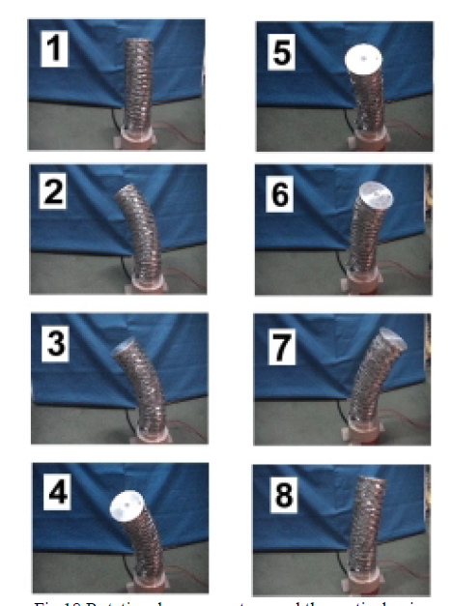
Performance
Notes:
Fig.18 shows the rotational movement around the
central axis, which was realized by changing the
desired posture little by little. The similar motion was
also realized by just switching the valves connected to
the tube for supplying, as there exists 7 combinations
including all three valves are connected.

Slide 31
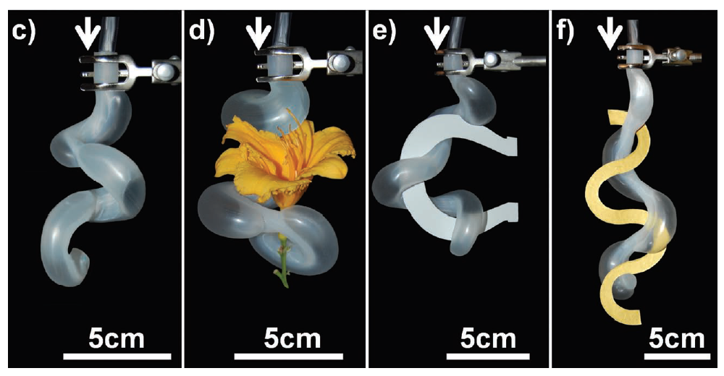
Literature Review
Robotic Tentacles with Three-Dimensional Mobility Based on Flexible Elastomers [8]
Notes:
This communication describes the design and fabrication
of soft tentacles based on micropneumatic networks spatially
distributed at the interface of two different elastomers; these
composite elastomeric structures enable complex 3D motion of
the tentacles. We demonstrate both the range of motion open
to these tentacles, and their capability to grip and manipulate
objects with complex shapes. We also extend the capabilities of
these soft actuators by embedding functional components (for
example, a needle for delivering fl uid, a video camera, and a
suction cup) in them. We further demonstrate that modifying
the texture of the surface of the tentacles can improve their
adhesion to slippery surfaces
We chose embedded pneumatic networks
(PneuNets) as the basis of our strategy for
supplying energy to the tentacles primarily
because air is light, compressible, readily
available, and low in viscosity (and thus permits
rapid actuation). The spatial distribution
of the pneumatic channels – which expand
like connected bladders upon pressurization
– determines the nature of the resulting
actuation. [ 23 ] For the tentacles we describe here, the pneumatic
networks are based on three indistinguishable channels along
the longitudinal direction of the tentacle. Combined actuation
of these channels generates movement in three dimension

Slide 32
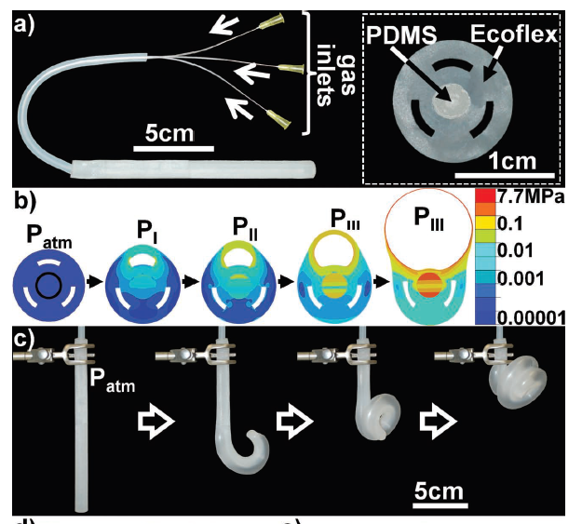
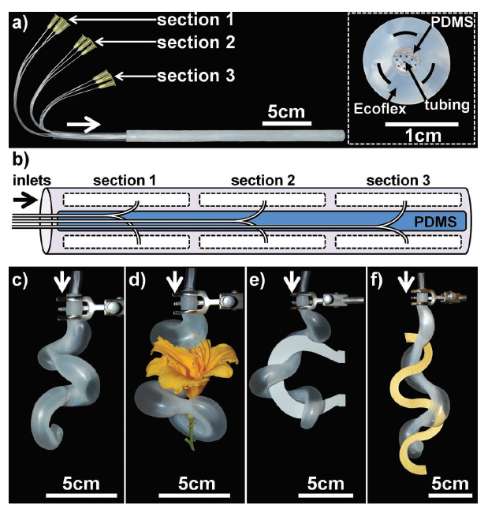
Design
Gripper
Notes:
Explain from the figure and the paper
How they are different and how we can make sections have different bends

Slide 33
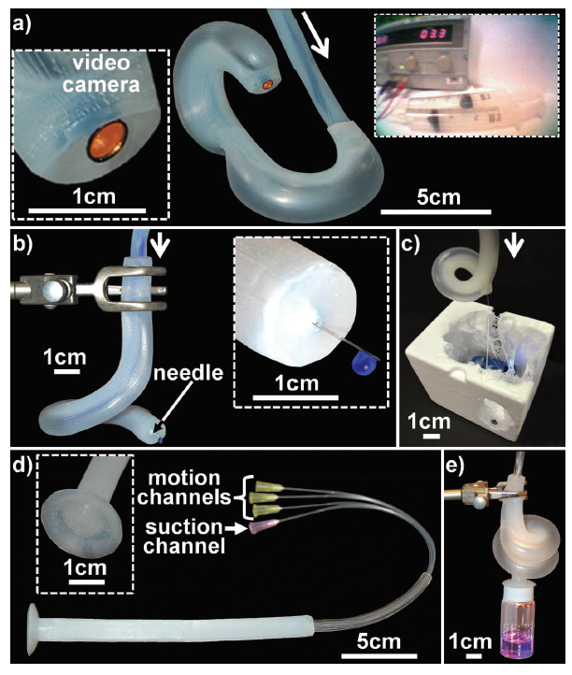
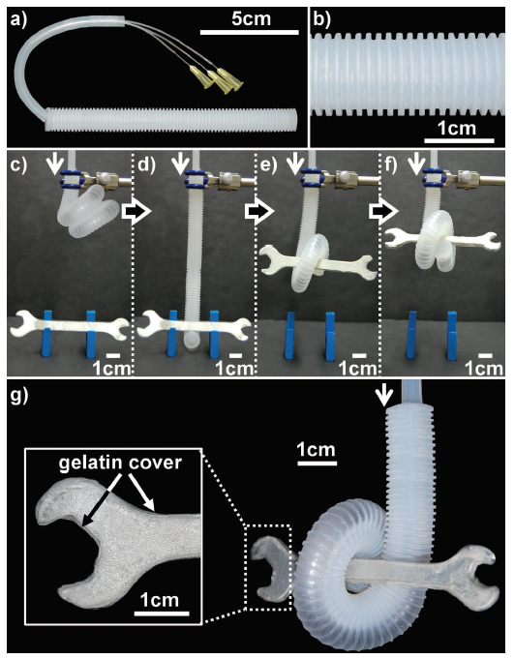
Applications
Notes:
Explain from the figure and the paper

Slide 34
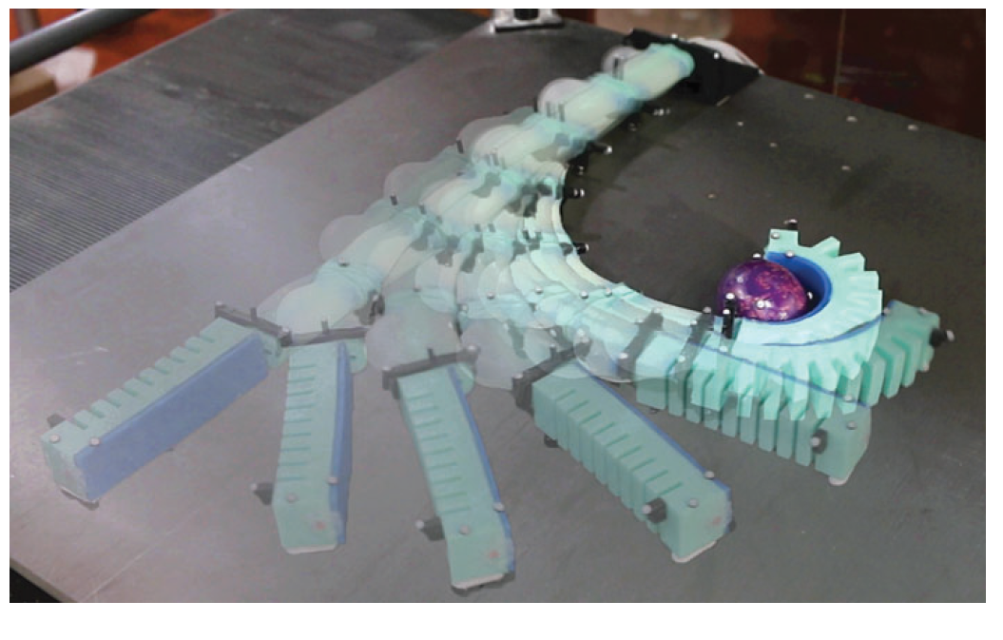
Literature Review
Autonomous Object Manipulation Using a Soft Planar Grasping Manipulator [9]
Notes:
The design of the gripper
itself is inspired by the work of Polygerinos et al.2 The design
is advantageous for grasping, because it exhibits high curvature,
minimal radial expansion, and remains compliant
during actuation. We can repeatably fabricate the gripper
using a lost-wax casting process instead of the commonly
used soft lithography technique. As a homogeneous piece
without weakening seams, the gripper is not prone to
delamination under high deformations. By abandoning the
need for a lamination process, arbitrarily shaped internal
channels can be achieved.
We attach the gripper to a multisegment soft manipulator
to enable autonomous grasp-and-place capabilities on a
plane. Positional feedback is provided in real-time from a
camera system. Modeling uncertainties arise from a simplifying
constant-curvature assumption, unrepresented manipulator
dynamics, stick-slip friction, and nonlinear fluidic
control. These uncertainties are compensated by the inherent
compliance of our soft gripper design and our motion planning
strategy. The motion planning algorithm advances the
arm through all the necessary states of the grasp-and-place
operation. A minimal strain, collision-free movement toward
the object of interest is found by posing the plan as a series of
constrained nonlinear optimization problems.

Slide 35
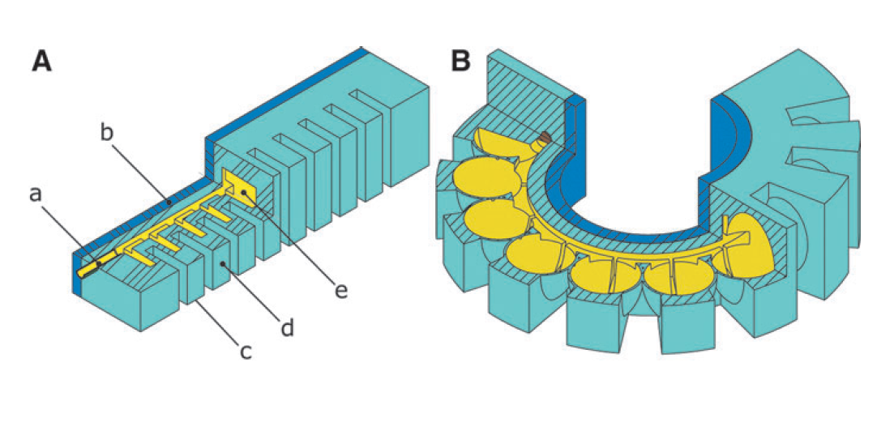
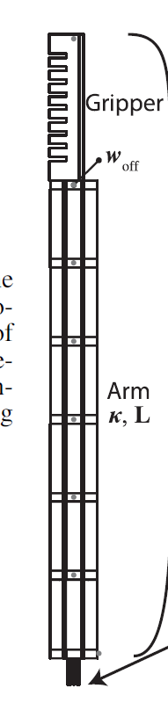
Pneu-nets
Gripper
Notes:
The design for the arm consisting of soft cylindrical segments
is described in Marchese et al.22 As is shown in
Marchese et al.,23 through the characterization of various
actuator morphologies, the concatenation of soft cylindrical
segments is most suitable to build up a robotic arm that can
create high blocking forces per fluid energy inserted. The
cylindrical segments of the arm are fabricated through a retractable
pin fabrication technique,22 which does not require
lost wax cores because of their simple cylindrical cavities.
Each cylindrical segment can be actuated up to a bend angle
of about 60; this requires several segments to be combined
together to allow the arm to reach a large enough workspace
to perform proper manipulation tasks on a plane. Using six
segments, the robot is able to touch its tip to its base without
interference from the individual joint limits. The cylindrical
segment design with its hollow channel in the center has
enough space to accommodate for pneumatic tubes to connect
to all six cylindrical segments and additionally to the
pleated gripper, which is attached to the tip. The pleated
gripper has to be appropriately sized, just big enough to allow
for proper manipulation without exceeding the payload
capacity of the soft arm.
The complete multisegment arm is supported off the
ground with two roller supports per segment. The rollers
minimize frictional forces to the surface. If the arm would be
moved over a nonslippery surface without rollers, the frictional
effects would greatly reduce the agility of the arm and
largely increase the stick-slip friction effects with the ground,
rendering the arm less useful

Slide 36

Planner for Grasp and Place
Notes:
As seen in this state flow diagram of the planner,
There are few blocks for the autonomous grasp and place
kinematic control
The forward kinematics algorithm forwKin () assumes
piecewise constant curvature
In order to uniquely fit a
configuration representation to measured endpoint data in
real-time, singSegInvKin (). The inputs
to this block are the start and endpoint measurements
Measured curvature kmeas and segment length Lmeas. A cascaded closedloop
curvature controller curvatureController ()
takes the target curvatures ktarget as its input and resolves the
error between ktarget and kmeas by continuously adjusting the
fluidic drive cylinder array.

Slide 37

Results
Notes:
Figure 7. In 23 of 25 experimental trials shown, the manipulator
successfully achieved the task of grasping an object
and placing it at a bin location shown in red. The test object
has a weight of 18 g and a diameter of 3.3 cm. The object was
placed five times on each of the five points marked on the
board. The markers only serve as a reference point for the user
to place the object roughly at the same point at every repetition.
The user’s placing accuracy is not important to the
algorithm, since the tracking system reregisters the position
of the object every time it is placed. The five points were
chosen to approximately represent the major portion of the
manipulator’s reachable workspace. As long as the root of the
gripper stops so that the object is located within the capture
region, the gripper will pick it up through its sweeping closing
motion.

Slide 38

Soft robots are Future[10]

Slide 39
References
A. Dameitry and H. Tsukagoshi, "Lightweight underactuated pneumatic fingers capable of grasping various objects," 2016 IEEE International Conference on Robotics and Automation (ICRA), Stockholm, 2016, pp. 2009-2014.
J. Zhou, S. Chen and Z. Wang, "A Soft-Robotic Gripper With Enhanced Object Adaptation and Grasping Reliability," in IEEE Robotics and Automation Letters, vol. 2, no. 4, pp. 2287-2293, Oct. 2017. doi: 10.1109/LRA.2017.2716445
B. S. Homberg, R. K. Katzschmann, M. R. Dogar and D. Rus, "Haptic identification of objects using a modular soft robotic gripper," 2015 IEEE/RSJ International Conference on Intelligent Robots and Systems (IROS), Hamburg, 2015, pp. 1698-1705.
Y. Wei et al., “A novel, variable stiffness robotic gripper based on integrated soft actuating and particle jamming,” Soft Robot., vol. 3, no. 3,pp. 134–143, 2016.
K. C. Galloway et al., “Soft robotic grippers for biological sampling on deep reefs,” Soft Robot., vol. 3, no. 1, pp. 23–33, 2016.
Calisti M, Giorelli M, Levy G, et al. An octopus bioinspired solution to movement and manipulation for soft robots. Bioinspiration Biomimetics.2011;6(3):036002
H. Tsukagoshi, A. Kitagawa and M. Segawa, "Active Hose: an artificial elephant's nose with maneuverability for rescue operation," Proceedings 2001 ICRA. IEEE International Conference on Robotics and Automation (Cat. No.01CH37164), 2001, pp. 2454-2459 vol.3.
R. V. Martinez et al., “Robotic tentacles with three-dimensional mobility based on flexible elastomers,” Adv. Mater., vol. 25, no. 2, p. 205,2013.
Katzschmann Robert K., Marchese Andrew D., and Rus Daniela.Soft Robotics.Dec 2015.
ALICI, G. (2018). Softer is Harder: What Differentiates Soft Robotics from Hard Robotics? MRS Advances, 1-12. doi:10.1557/adv.2018.159
Mcmahan, William & Jones, Bryan & Walker, Ian & Chitrakaran, V.K. & Seshadri, Arjun & Dawson, Darren. (2011). Robotic manipulators inspired by cephalopod limbs. Proceedings of the Canadian Design Engineering Network Conference. 10.24908/pceea.v0i0.3994.
https://www.youtube.com/watch?v=949eYdEz3Es

